Slide 1
S E S S I O N 2 5
Diffusion Models & Stable Diffusion
How AI paints images out of pure noise — the technology behind Stable Diffusion, DALL·E and Midjourney
xᴛ ~ N(0, I) → denoise × T steps → x₀ (a brand-new image)
Theory + guided code walkthrough · ~1.5 hours · Computer Vision & AI Course
Notes:
Welcome. Frame: last sessions were about understanding images and language; today the model CREATES. One formula on screen: start from pure noise, remove it step by step. Ask what they've tried with AI image tools.

Slide 2
Today's Agenda
One idea, three zoom levels: the math, the machine, the practice
PART 1 · DIFFUSION THEORY | ~30 min
PART 2 · INSIDE STABLE DIFFUSION | ~30 min
PART 3 · SD IN PRACTICE | ~30 min
The big idea: destroy, then rebuild
Forward process — adding noise
Reverse process — learning to denoise
DDPM — just predict the noise
Noise schedules — linear vs cosine
DDIM — 20× faster sampling
Why pixel-space diffusion is too slow
The three components
VAE — the latent space
CLIP — the text encoder
UNet + cross-attention
The full architecture, end to end
The Diffusers library
Knobs: steps, guidance scale, seed
img2img — start from an image
Inpainting — edit with a mask
ControlNet — precise spatial control
Recap + what's next
Session 25 · Diffusion Models & Stable Diffusion
2
Notes:
Three parts, ~30 min each. Part 1 = math intuition (no heavy derivations). Part 2 = why SD is fast and how text steers it. Part 3 = the exact tools used in the lab notebook.

Slide 3
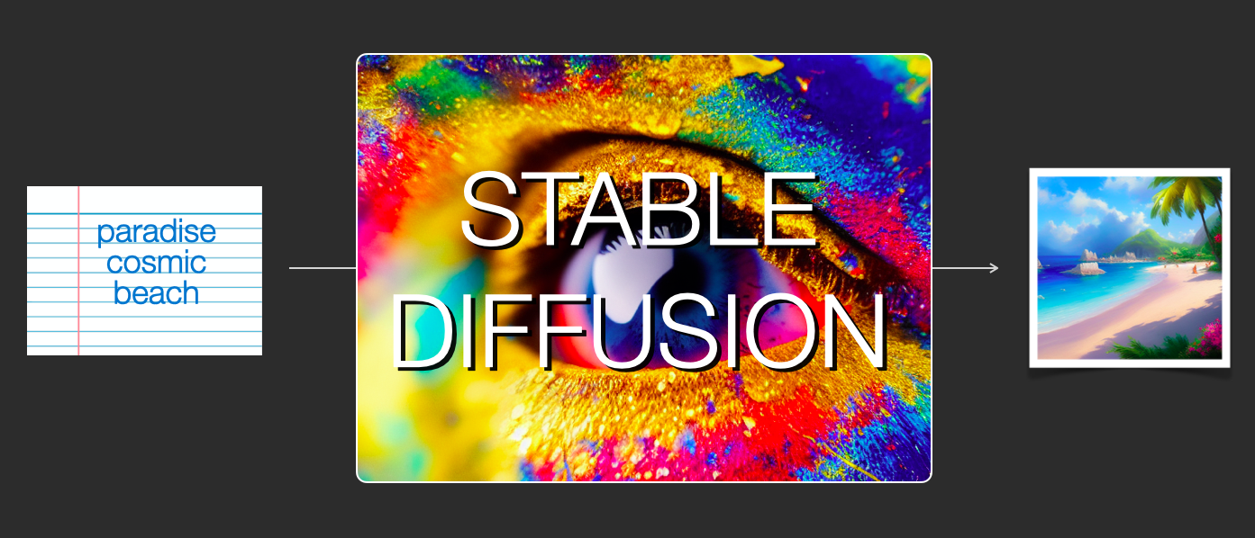
The Big Idea: Destroy, Then Learn to Rebuild
Every diffusion model is trained by wrecking images — and learning to undo the damage
Two processes, one model. A fixed forward process gradually drowns an image in noise; a learned reverse process removes the noise step by step.
The training task is humble: “here is a noisy image — tell me what noise was added.” That's it. No adversary, no discriminator.
Generation = pure imagination: start from 100% noise and denoise repeatedly — an image appears that never existed.
This one recipe powers Stable Diffusion, DALL·E 2, Midjourney and Imagen.
Image: Jay Alammar, “The Illustrated Stable Diffusion” (CC BY-NC-SA 4.0)
Why not a GAN? GANs are fast but famously unstable to train and prone to mode collapse. Diffusion trades speed for stable training and excellent diversity — and Part 1 ends with the speed fix.
Session 25 · Diffusion Models & Stable Diffusion
3
Notes:
Painter analogy: photo restorer who has fixed millions of damaged photos can 'restore' pure static into a new photo. Connect to Week 11 generative overview: GAN instability vs diffusion stability.

Slide 4
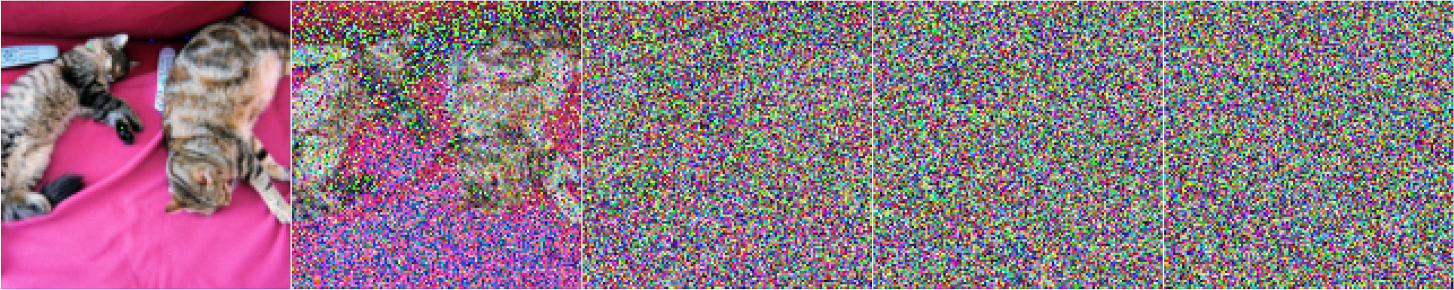
The Forward Process: Drowning an Image in Noise
A fixed, learning-free recipe — T small steps from photo to pure static
Image: Hugging Face, “The Annotated Diffusion Model” — forward diffusion of a cat, t = 0 → T
A Markov chain of T steps (DDPM uses T = 1000): each step adds a small dose of Gaussian noise.
Nothing is learned here — it's a fixed schedule of noise amounts βₜ, chosen before training.
The shortcut that makes training practical: jump from x₀ straight to any xₜ in one line — no need to simulate t steps.
THE FORWARD PROCESS, FORMALLY
q(xₜ | xₜ₋₁) = N(√(1−βₜ)·xₜ₋₁, βₜ·I)
shortcut to any step t:
xₜ = √ᾱₜ·x₀ + √(1−ᾱₜ)·ε
ε ~ N(0, I), ᾱₜ = ∏ₛ (1−βₛ) → “signal left at t”
Session 25 · Diffusion Models & Stable Diffusion
4
Notes:
Walk the cat strip left to right. Stress: forward = fixed, no learning. Shortcut formula is why training is cheap — sample any t directly. ᾱ = how much original signal survives.

Slide 5
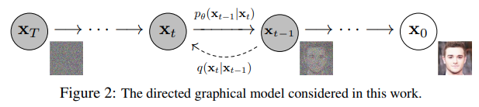
The Reverse Process: Learning to Denoise
Running the film backwards — this is where the neural network comes in
Figure: Ho et al. 2020, “Denoising Diffusion Probabilistic Models” — via Hugging Face, “The Annotated Diffusion Model”
Exactly inverting noise is impossible — but for tiny βₜ, each reverse step is also a simple Gaussian.
So we learn its mean with a network εθ: look at noisy xₜ, estimate the noise hiding inside it.
One network for all 1000 steps — the timestep t enters as an embedding, like a dial telling it how noisy the input is.
THE REVERSE PROCESS, FORMALLY
pθ(xₜ₋₁ | xₜ) = N(μθ(xₜ, t), σₜ²·I)
μθ is computed from the network's
noise estimate εθ(xₜ, t)
solid arrows = learned · dashed = fixed forward
Session 25 · Diffusion Models & Stable Diffusion
5
Notes:
Figure 2 of the DDPM paper: dashed arrow = fixed forward q, solid = learned reverse p. Key theory nugget: small steps keep the reverse Gaussian — that's WHY T is large.

Slide 6
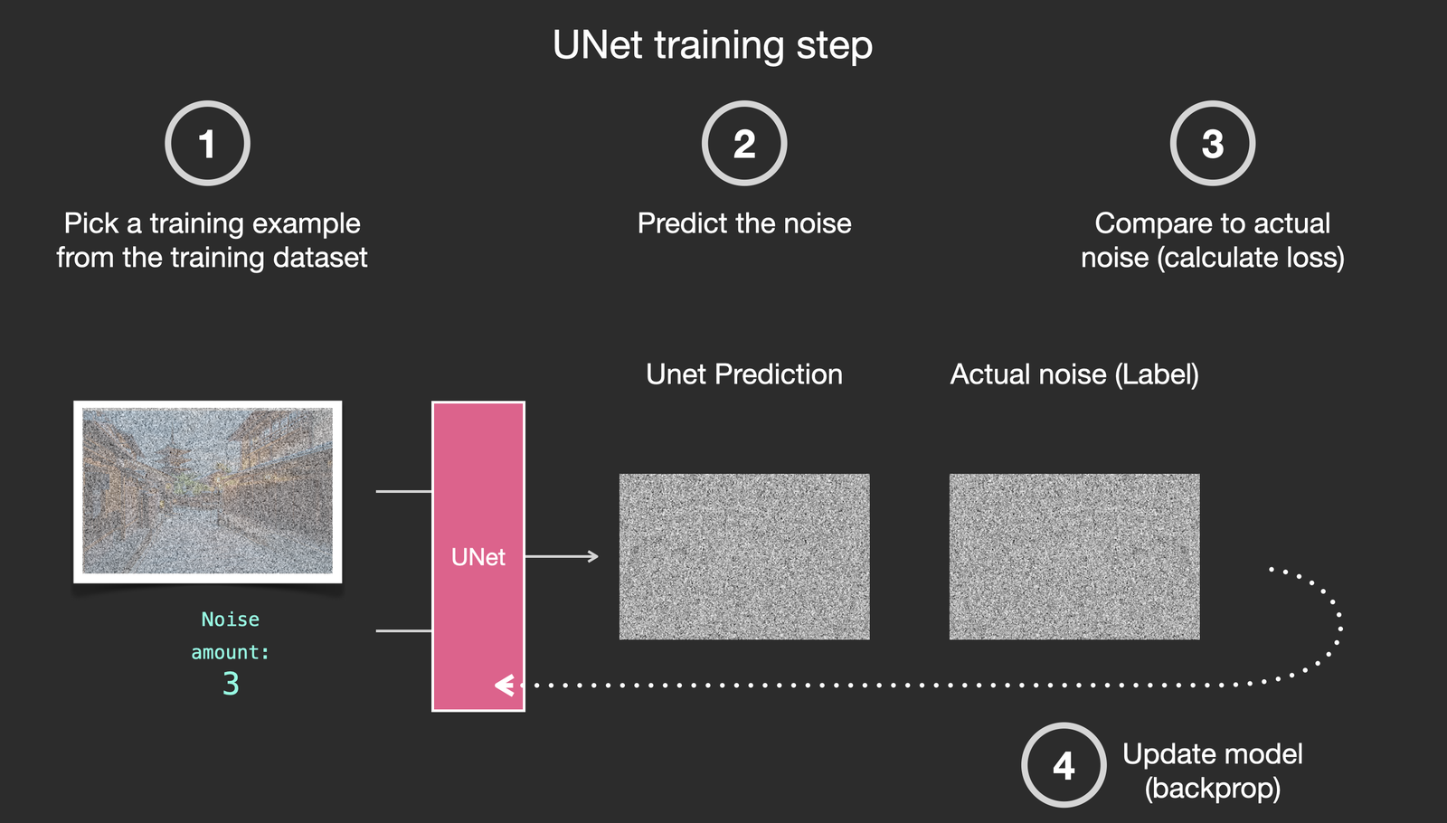
DDPM: Train a Noise Predictor
The 2020 paper that made diffusion work — with an almost embarrassingly simple loss
Sample: pick a training image x₀ and a random timestep t.
Corrupt: make xₜ with the one-line shortcut — and remember the exact noise ε you used.
Predict: the UNet sees (xₜ, t) and guesses the noise.
Learn: mean-squared error between guess and truth. Repeat millions of times.
THE ENTIRE LOSS FUNCTION
Image: Jay Alammar, “The Illustrated Stable Diffusion” (CC BY-NC-SA 4.0)
L = ‖ε − εθ(xₜ, t)‖²
Session 25 · Diffusion Models & Stable Diffusion
6
Notes:
Compare with GAN training (two networks fighting) — here: one network, one MSE loss, totally stable. Ask: why predict ε rather than the clean image? (Same information via the shortcut formula, but an easier, better-conditioned target.)

Slide 7
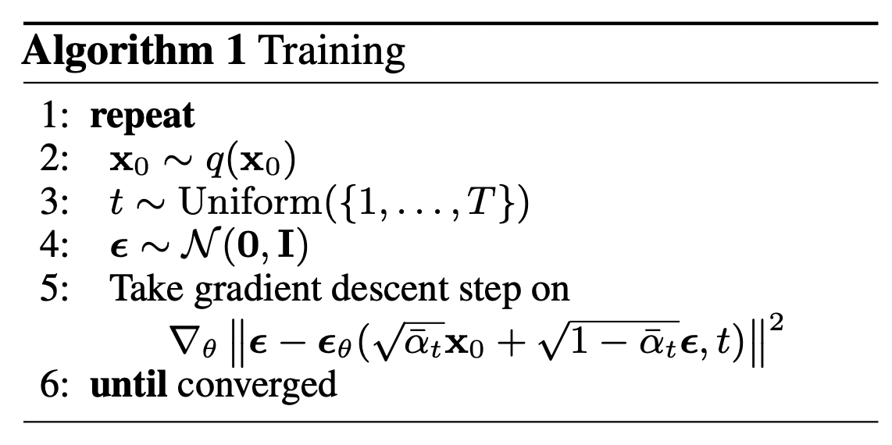
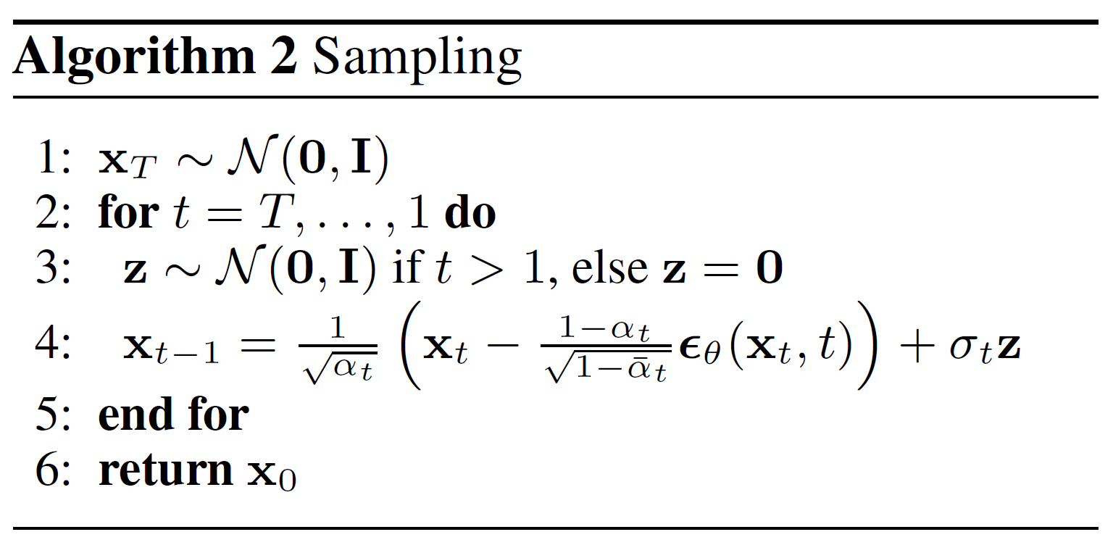
The Whole Paper in Two Boxes
DDPM training and sampling — pseudocode straight from Ho et al. 2020
TRAINING
SAMPLING (GENERATION)
Algorithms: Ho et al. 2020 (arXiv:2006.11239) — via Hugging Face, “The Annotated Diffusion Model”
Left: line 5 is the MSE loss from the previous slide — nothing else is happening.
Right: start at pure noise xᴛ, loop t = T…1: subtract predicted noise, add back a pinch of fresh noise (σₜz) — pure sculpting.
Session 25 · Diffusion Models & Stable Diffusion
7
Notes:
Give them the confidence moment: 'you can now read the actual paper — these two boxes ARE the method.' The σz term keeps sampling stochastic; foreshadow DDIM removing it.

Slide 8
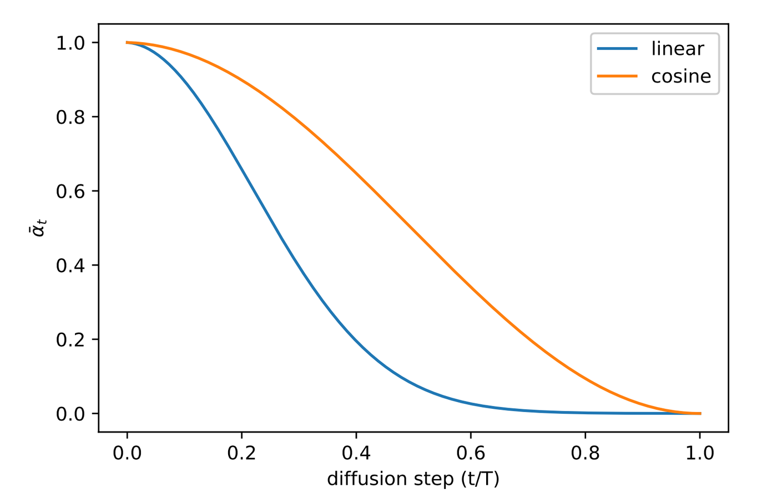
Noise Schedules: How Fast Do We Destroy?
The βₜ sequence is a design choice — and it matters more than it looks
βₜ = noise added at step t; ᾱₜ (plotted) = fraction of original signal still alive at step t.
Linear schedule: signal collapses early — the last hundreds of steps stare at near-pure noise and learn little.
Cosine schedule: spends the noise budget evenly, keeps images informative longer → better samples (Improved DDPM, 2021).
Stable Diffusion uses a scaled-linear schedule — tuned for latents, not pixels.
Figure: Nichol & Dhariwal 2021 — via Lilian Weng, “What are Diffusion Models?”
Same network, same data — a better schedule alone measurably improves image quality.
Session 25 · Diffusion Models & Stable Diffusion
8
Notes:
Read the plot: y-axis = surviving signal. Blue (linear) dives early; orange (cosine) degrades gracefully. Analogy: exam with all hard questions in the first 10 minutes vs spread out.

Slide 9
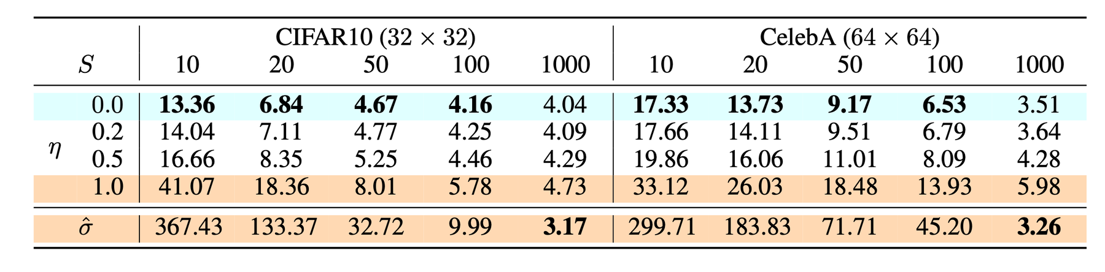
DDIM: Same Model, 20× Fewer Steps
Denoising Diffusion Implicit Models — the sampler that made diffusion usable
DDPM's price tag: 1000 network calls per image — minutes per sample.
DDIM's insight: the same trained network defines a deterministic, non-Markovian path — you may take big strides along it.
1000 → 50 steps with barely any quality loss; → 20 in a pinch.
Deterministic: no σₜz noise re-injection — the same starting latent always yields the same image (seeds, interpolation!).
Legacy: today's samplers (Euler, DPM++, …) are its descendants — in code, just a swappable “scheduler”.
READ THE TABLE
FID on CIFAR-10 (lower = better): 1000-step DDPM scores 3.17; 50-step DDIM scores 4.67; even 20 steps stays respectable at 6.84.
20× less compute, almost the same quality.
Table: Song et al. 2021, “Denoising Diffusion Implicit Models” — via Lilian Weng
Part 1 recap ✓ — we can train a noise predictor with plain MSE, and sample from it fast.
Session 25 · Diffusion Models & Stable Diffusion
9
Notes:
η=0 row of the table = DDIM. Emphasize practical takeaway: sampler choice is a free-lunch speedup — no retraining. This closes the theory act; take questions before Part 2.

Slide 10
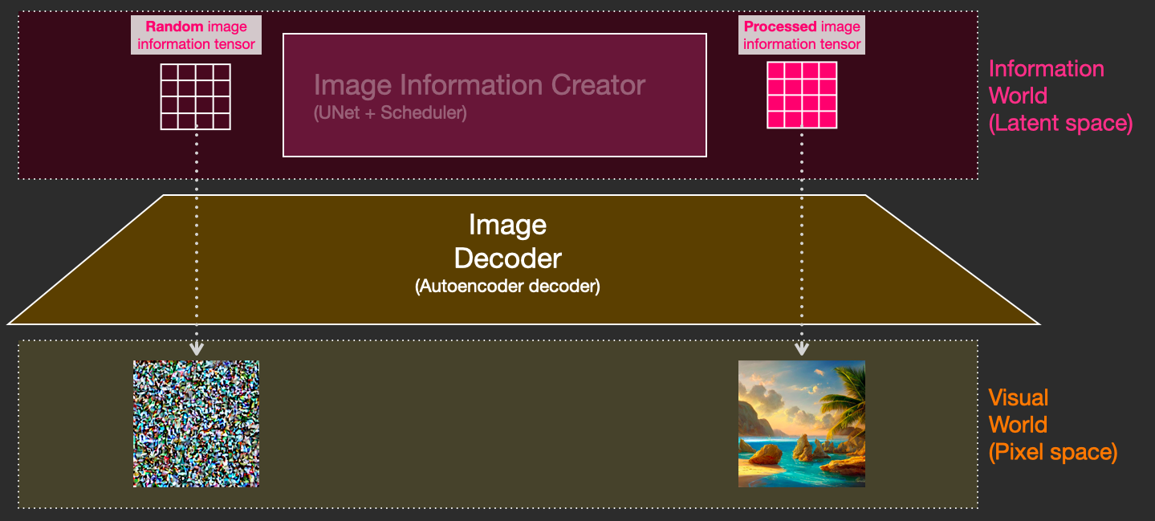
The Problem: Pixel Diffusion Is Expensive
DDPM works beautifully — at a price nobody can pay at 512×512
786,432
values in one 512×512 RGB image — the UNet must touch every one, every step
× 50–1000
denoising steps per image — the whole network runs again each step
Image: Jay Alammar, “The Illustrated Stable Diffusion” (CC BY-NC-SA 4.0)
4 × 64 × 64
Stable Diffusion's move: diffuse a compressed latent — 48× fewer values
Stable Diffusion = “latent diffusion”: compress first, diffuse in miniature, decode once at the end.
Session 25 · Diffusion Models & Stable Diffusion
10
Notes:
This is the bridge slide: everything from Part 1 stays true — we just change WHERE it runs. Latent = compressed 'information space' image; decoder turns it back into pixels.

Slide 11
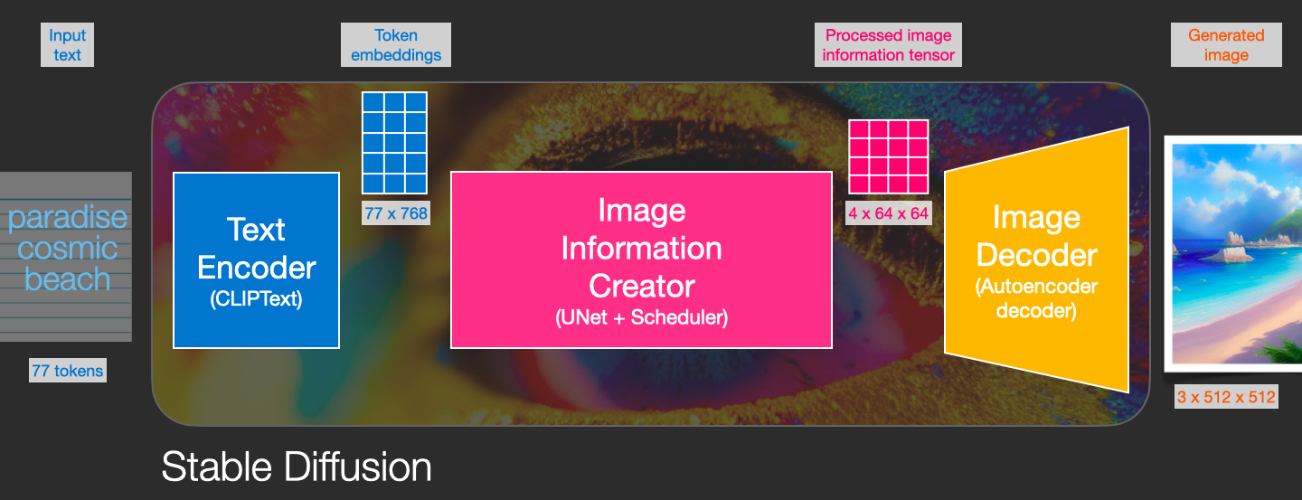
Stable Diffusion = Three Networks in a Trench Coat
A text encoder, a latent noise-predictor, and an image decoder — with the tensors between them
Image: Jay Alammar, “The Illustrated Stable Diffusion” (CC BY-NC-SA 4.0)
A reader (CLIPText → 77×768 embeddings), a painter working in miniature (UNet + scheduler → 4×64×64 latent), and a developer of the film (VAE decoder → 3×512×512 pixels).
Session 25 · Diffusion Models & Stable Diffusion
11
Notes:
THE map of Part 2. Trace the tensor shapes out loud — they recur all session: 77×768 text matrix, 4×64×64 latent, 3×512×512 image. Next three slides zoom into each box.

Slide 12
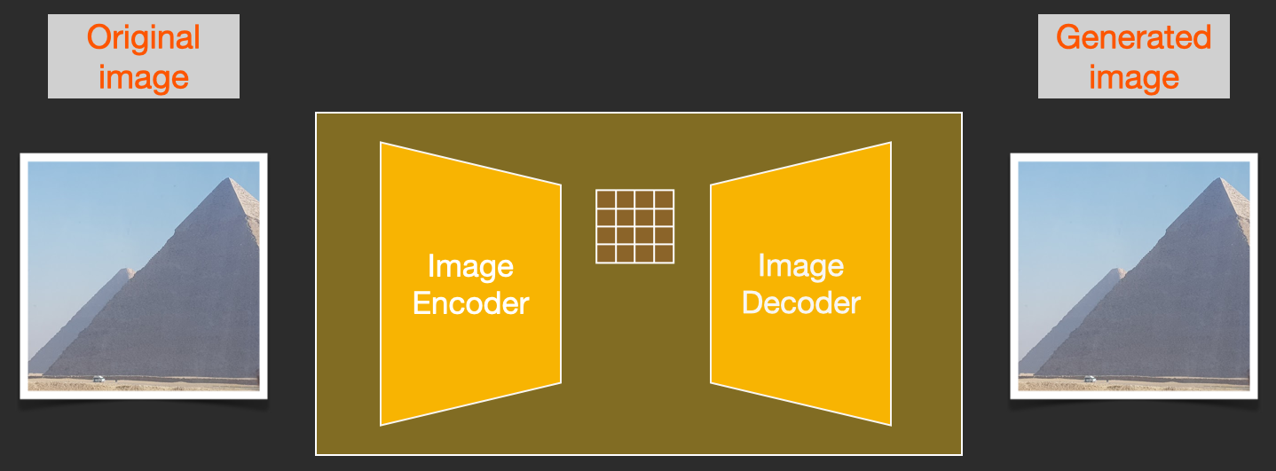
The VAE: Where Images Get Small
An autoencoder gives diffusion a 48× cheaper place to live
Trained separately, on millions of images, to compress and reconstruct almost losslessly.
Perceptual + adversarial losses keep textures and edges sharp — not the blurry VAEs from the GAN session.
The latent isn't a thumbnail: it's a learned code capturing content and layout — the model's sketchpad.
At generation time the encoder isn't needed at all — the decoder runs exactly once, after the last denoising step.
Image: Jay Alammar, “The Illustrated Stable Diffusion” (CC BY-NC-SA 4.0)
THE COMPRESSION DEAL
encode: 3×512×512 → 4×64×64
decode: 4×64×64 → 3×512×512 (×48 smaller inside)
Session 25 · Diffusion Models & Stable Diffusion
12
Notes:
Demo idea for lab: encode → decode a photo and compare. Mention 'developing the film' metaphor for the decoder. Encoder is used in training and img2img — that returns in Part 3.

Slide 13
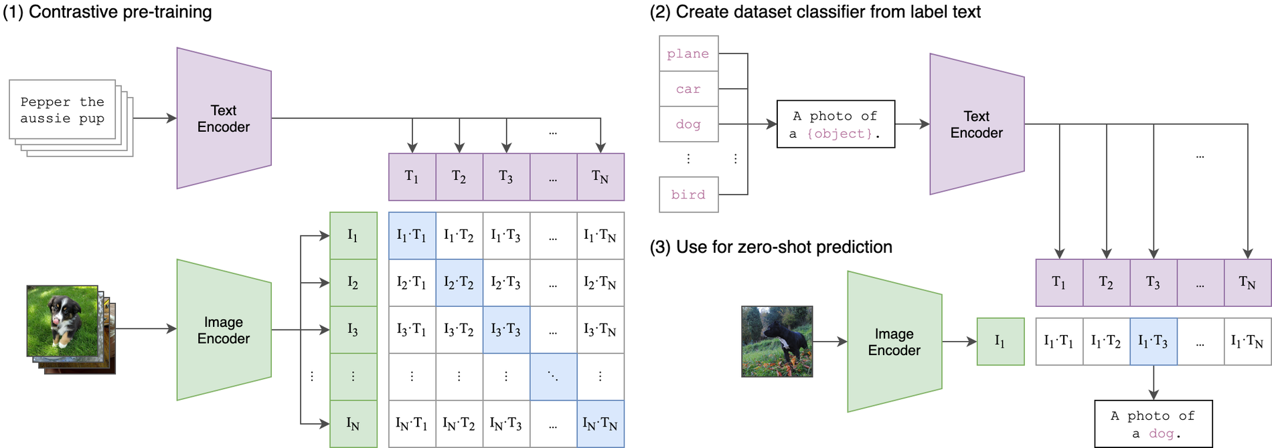
CLIP: How the Model Reads Your Prompt
Contrastive pre-training on 400M image–caption pairs — words and pictures in one space
Figure: Radford et al. 2021, “Learning Transferable Visual Models From Natural Language Supervision” (OpenAI CLIP)
How it's trained: matching image–caption pairs are pulled together, mismatches pushed apart (blue diagonal).
What SD borrows: only the frozen text encoder — your prompt becomes 77 token vectors of 768 numbers.
Session 25 · Diffusion Models & Stable Diffusion
13
Notes:
Left panel of figure = contrastive training; right = zero-shot use (skip quickly). Punchline: CLIP embeddings 'know' what things look like — that's why they can steer image generation.

Slide 14
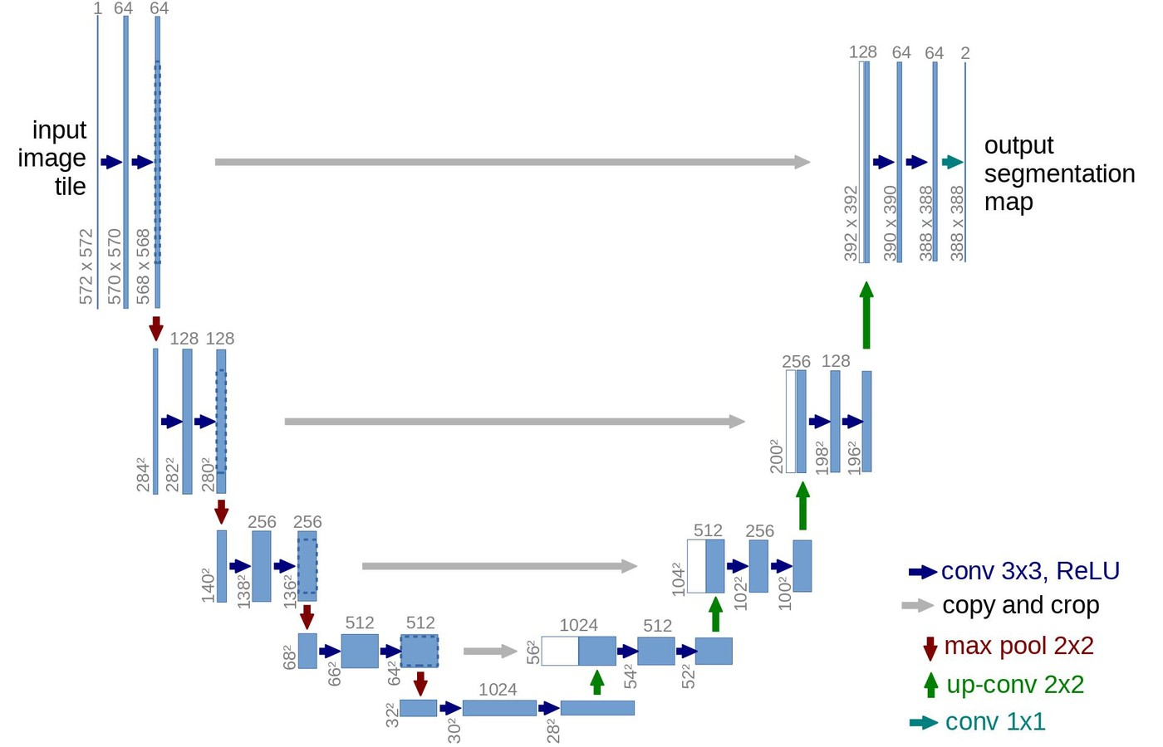
The UNet: An Old Friend With a New Job
The segmentation workhorse, reborn as Stable Diffusion's noise predictor
Same shape you know: contracting path builds context, expanding path restores resolution, skip connections carry fine detail across.
Perfect for denoising — output must be pixel-aligned with input, just like a segmentation mask.
In Stable Diffusion it works on latents: in 4×64×64, out 4×64×64 — the predicted noise.
Two extra inputs: the timestep t (as an embedding) and the text — next slide.
Scale: ~860M parameters in SD 1.5 — the biggest of the three components.
Figure: Ronneberger et al. 2015, “U-Net: Convolutional Networks for Biomedical Image Segmentation”
Session 25 · Diffusion Models & Stable Diffusion
14
Notes:
Callback to the segmentation session — they've built one. New job, same skeleton: 'what noise is hiding here?' instead of 'which pixel is which class?'

Slide 15
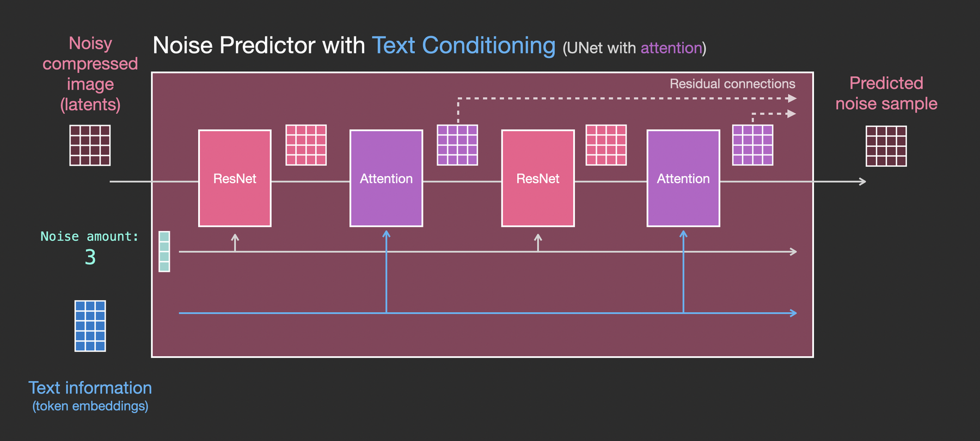
Cross-Attention: Where Words Steer Pixels
Inside the UNet, attention layers let the latent consult your prompt at every step
Image: Jay Alammar, “The Illustrated Stable Diffusion” (CC BY-NC-SA 4.0)
ResNet blocks process the image; attention blocks let every latent patch ask the 77 text vectors: “what should I become?” — queries from the latent, keys and values from your prompt.
Session 25 · Diffusion Models & Stable Diffusion
15
Notes:
Bridge from Session 23 (attention/Transformers): same Q/K/V math, but Q comes from image latents and K,V from text tokens — hence CROSS-attention. Without these layers, prompts would do nothing.

Slide 16
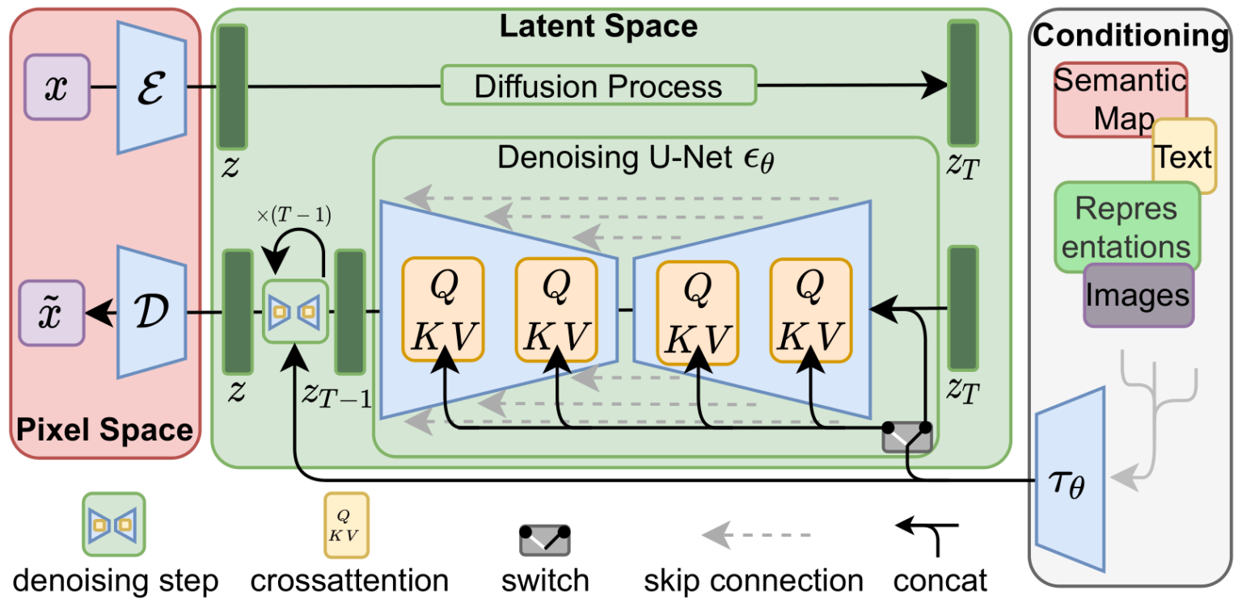
The Full Architecture on One Slide
Figure 3 of the Stable Diffusion paper — you can now read every box
1
Pixel space (left): the VAE encoder ℰ compresses x to latent z — training and img2img only.
2
Diffusion process (top): forward noising happens in latent space.
3
Denoising UNet εθ (center): predicts noise; Q·K·V blocks are the cross-attention taps.
4
Conditioning τθ (right): text → CLIP embeddings feeding every attention layer; decoder D paints pixels at the end.
Figure: Rombach et al. 2022, “High-Resolution Image Synthesis with Latent Diffusion Models” (CVPR)
Session 25 · Diffusion Models & Stable Diffusion
16
Notes:
Victory-lap slide: every box was a slide today. Trace one generation: noise z_T → UNet loop with text → z → decoder → image. Note the switch: conditioning can also be maps/layouts — seed for ControlNet.

Slide 17
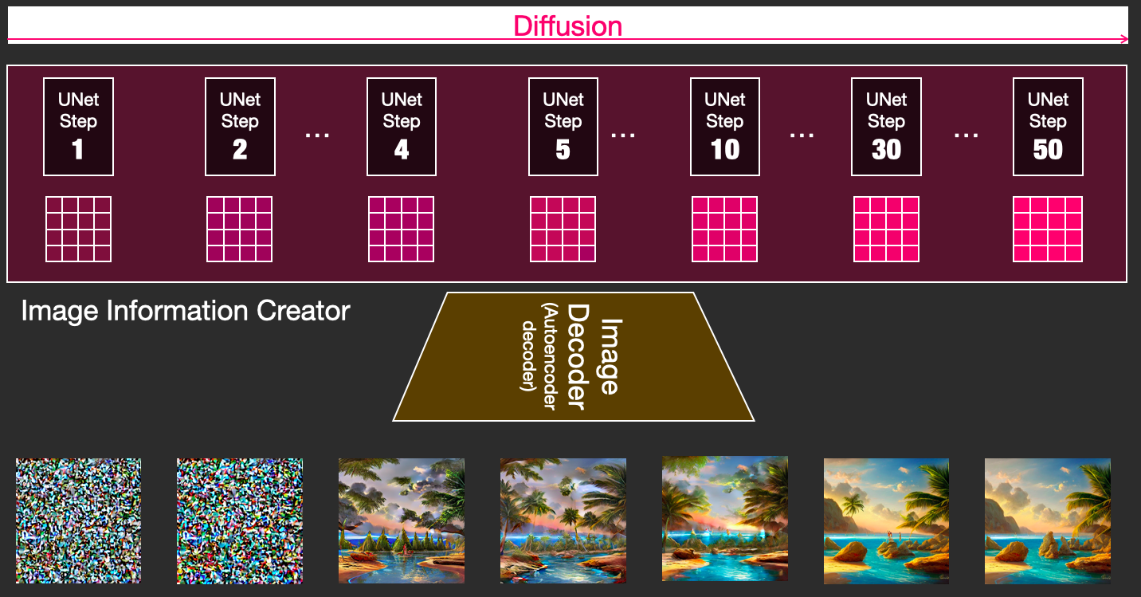
Watching an Image Emerge — and Your Three Knobs
Decoding the latent at intermediate steps shows the picture crystallising
num_inference_steps
20–50 with modern samplers. More steps = more refinement, linearly more time.
guidance_scale (CFG)
How strongly to follow the prompt (typ. 7–8). Runs the UNet with and without text, then exaggerates the difference. Too high → burnt, oversaturated look.
seed / generator
Fixes the starting noise — same seed + prompt + settings = identical image.
Image: Jay Alammar, “The Illustrated Stable Diffusion” (CC BY-NC-SA 4.0)
Session 25 · Diffusion Models & Stable Diffusion
17
Notes:
Left: latents decoded every few steps — outline first, details last. CFG intuition: 'with-text minus without-text, amplified.' These three parameters are 90% of everyday control.

Slide 18
The Diffusers Library: SD in Ten Lines
Hugging Face's toolbox — pipelines bundle VAE + CLIP + UNet + scheduler for you
TEXT → IMAGE, COMPLETE AND RUNNABLE
One pipeline object loads and wires all three networks + the scheduler.
Swap the sampler in one line: DPMSolverMultistepScheduler → great images in ~20 steps.
fp16 weights fit in ~4 GB VRAM — free Colab T4 runs this comfortably.
Same pattern everywhere: img2img, inpainting and ControlNet are sibling pipelines — next three slides.
from diffusers import StableDiffusionPipeline
import torch
pipe = StableDiffusionPipeline.from_pretrained(
"sd-legacy/stable-diffusion-v1-5",
torch_dtype=torch.float16).to("cuda")
image = pipe(
"a cozy cabin in a snowy forest, golden hour",
num_inference_steps=30,
guidance_scale=7.5,
generator=torch.Generator("cuda").manual_seed(42),
).images[0]
image.save("cabin.png")
Session 25 · Diffusion Models & Stable Diffusion
18
Notes:
Walk the code line by line — they will run exactly this in the lab. Point at the three knobs from the previous slide appearing as arguments. negative_prompt also exists — mention briefly.

Slide 19
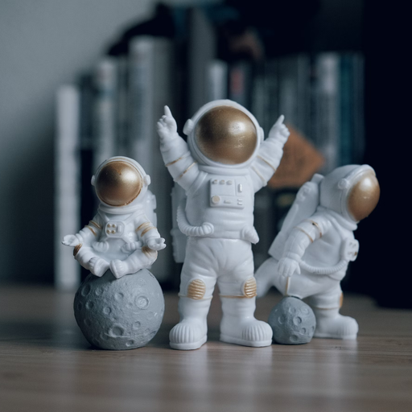
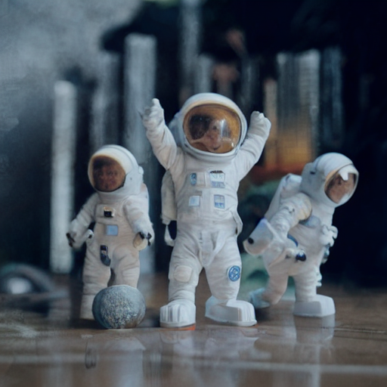
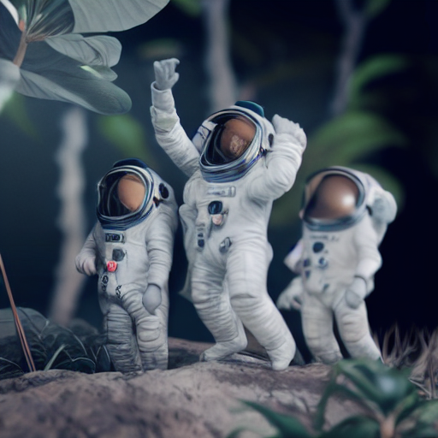
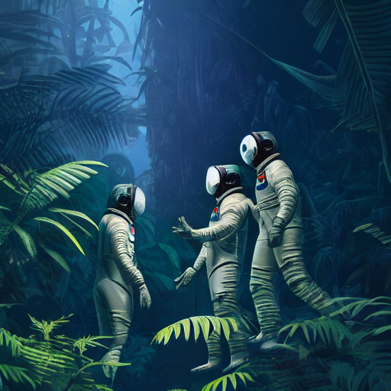
img2img: Start From an Image, Not From Noise
Encode your image, add partial noise, denoise with a prompt — strength decides how much changes
input image
strength 0.4
strength 0.6
strength 1.0
prompt: “Astronaut in a jungle, cold color palette, muted colors, detailed, 8k”
Images: Hugging Face Diffusers documentation (huggingface.co/docs/diffusers)
How: VAE-encode the input → jump partway into the noise schedule → denoise from there, guided by your prompt.
strength = how far in you jump: 0.0 returns your image untouched; 1.0 ignores it completely — the sweet spot for restyling is ~0.5–0.7.
Session 25 · Diffusion Models & Stable Diffusion
19
Notes:
Read the strip: composition survives at 0.4, style shifts by 0.6, input is gone at 1.0. No retraining involved — it's the same model entering the loop midway. Uses: sketch→render, restyle, upscale passes.

Slide 20
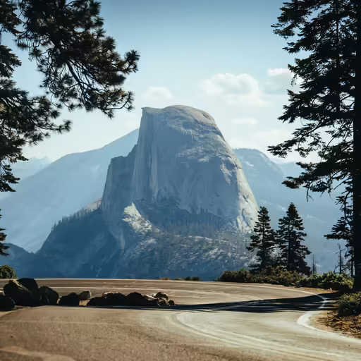
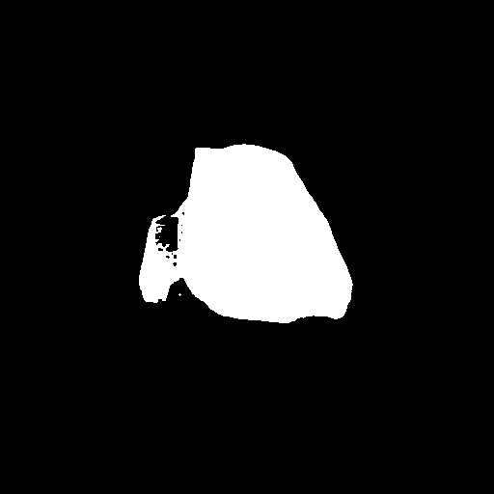

Inpainting: Edit Only Where the Mask Says
Regenerate a region from a prompt while every other pixel stays put
original
mask (white = repaint)
result
prompt: “black cat with glowing eyes, cute, adorable, highly detailed, 8k”
Images: Hugging Face Diffusers documentation (huggingface.co/docs/diffusers)
Each denoising step: masked latents get generated, unmasked latents get copied from the original — so the seam blends naturally.
Best results: dedicated inpainting checkpoints take the mask as an extra UNet input. Uses: remove objects, replace them, swap backgrounds.
Session 25 · Diffusion Models & Stable Diffusion
20
Notes:
Point at the mountain → cat swap: trees, road and sky are pixel-identical. Photoshop's Generative Fill is exactly this. Mask can be hand-drawn or come from a segmentation model — ties into the course's GenAI pipeline goal (search→segment→inpaint).

Slide 21
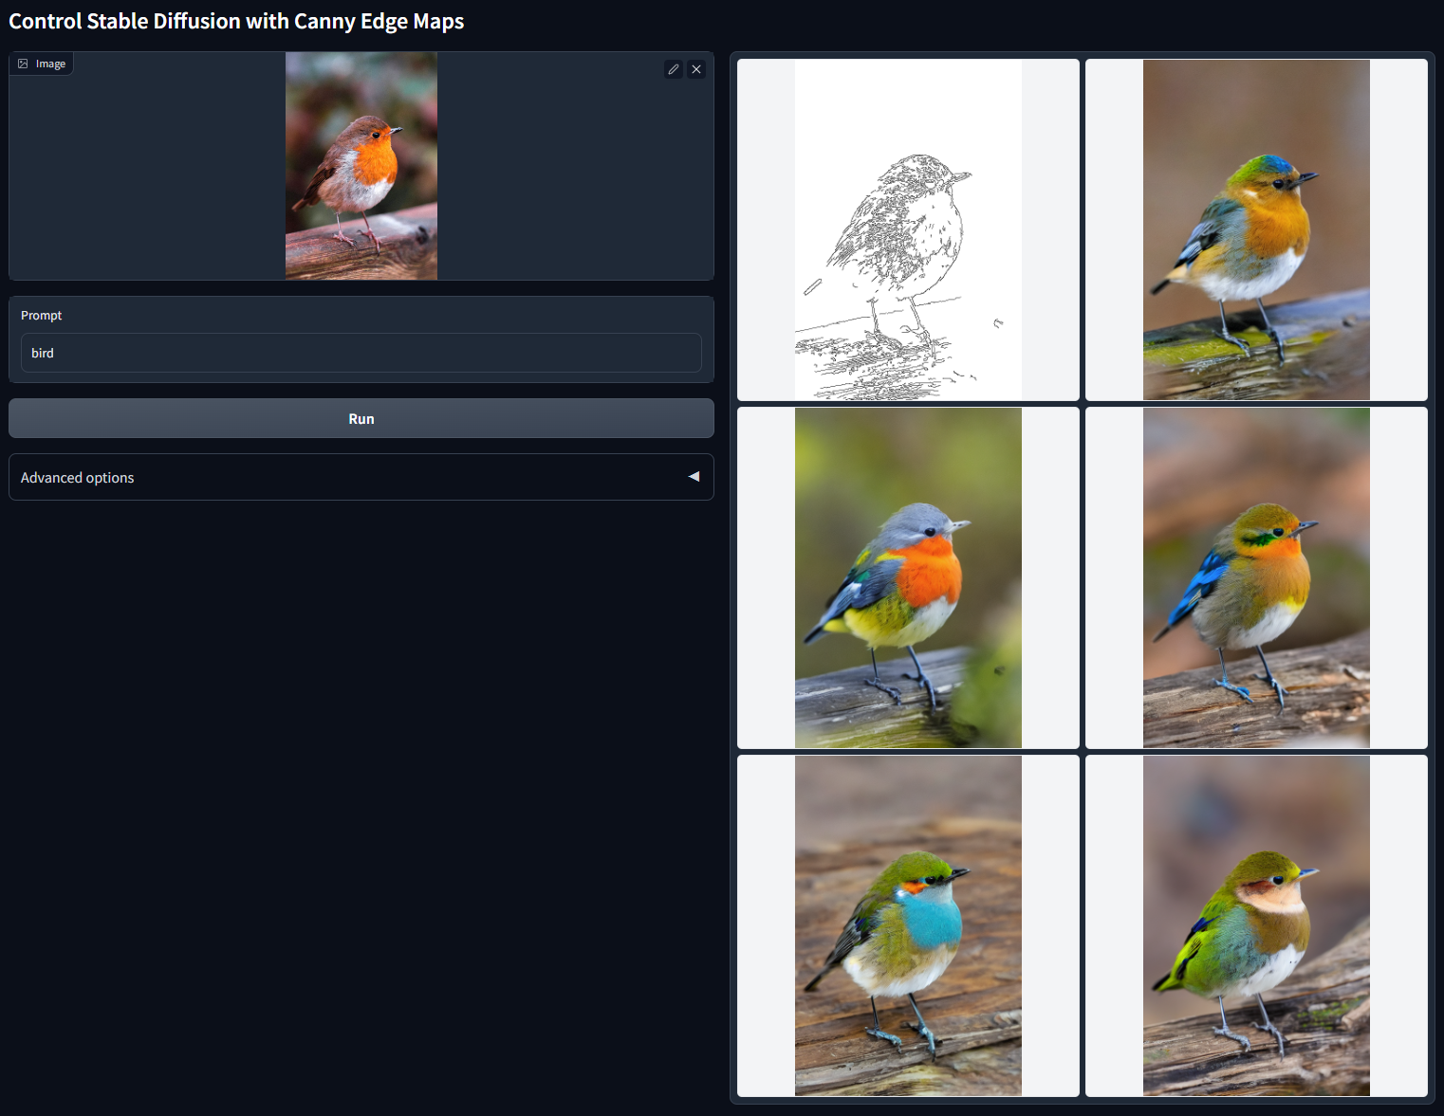
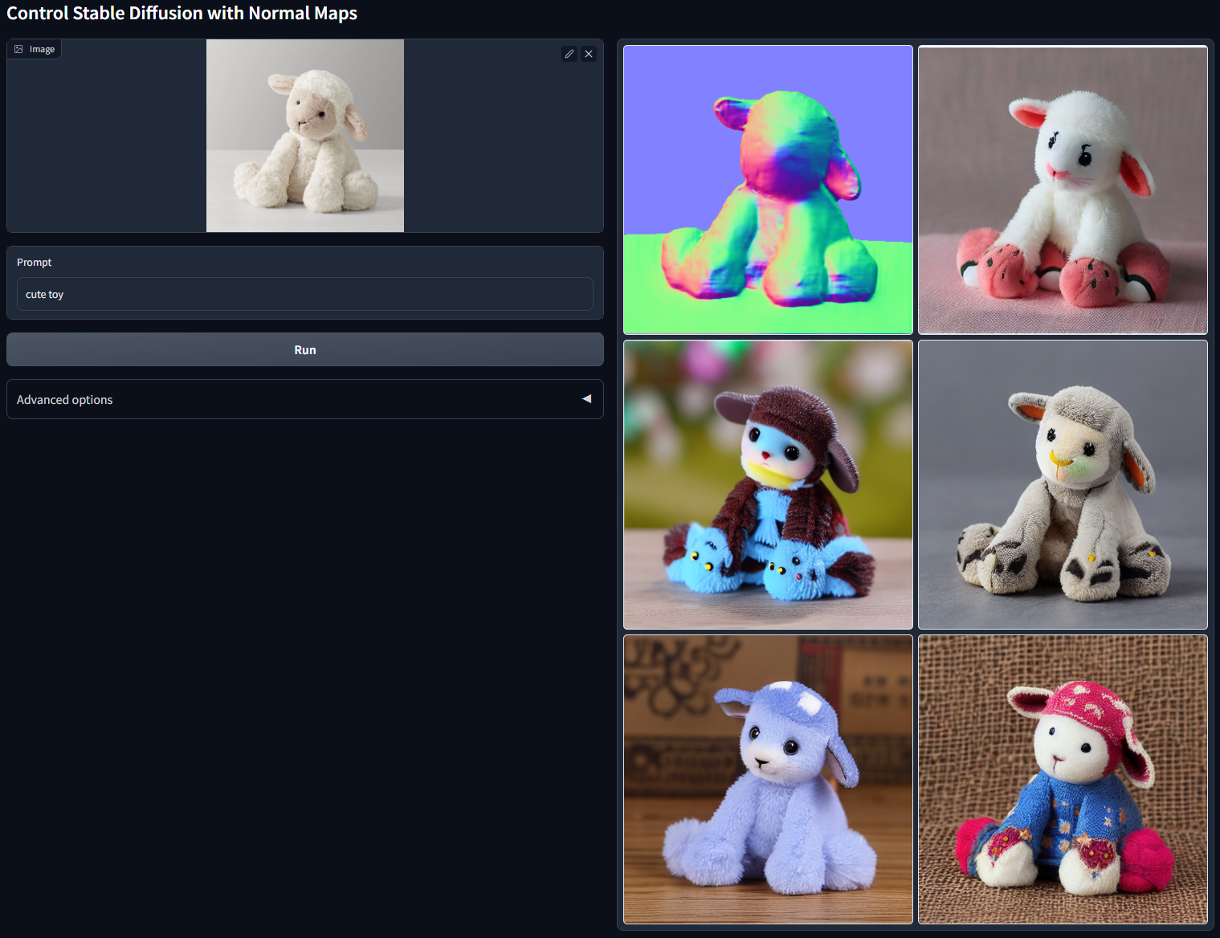
ControlNet: Precision Steering for Stable Diffusion
When a prompt can't say “exactly this pose, exactly these edges” — show it instead
Canny-edge conditioning — prompt: “bird”
Normal-map conditioning — prompt: “cute toy”
Images: Zhang et al. 2023, “Adding Conditional Control to Text-to-Image Diffusion Models” (github.com/lllyasviel/ControlNet)
The trick: a trainable copy of the UNet encoder learns the condition; the original SD weights stay frozen — zero-convolutions keep training from destroying them.
One extra input image — edges, depth, human pose, scribbles, normal maps — pins down layout while the prompt controls content and style.
Session 25 · Diffusion Models & Stable Diffusion
21
Notes:
Left: one edge map, six faithful birds — layout locked, appearance free. Framing: prompt = WHAT, ControlNet = WHERE. Skim the architecture detail; depth per audience interest.

Slide 22
What You Now Know
From a single MSE loss to a controllable image-generation system
THE ARC OF TODAY
NEXT SESSION
Diffusion theory: a fixed forward process makes noise; a UNet trained with ‖ε − εθ‖² reverses it; schedules shape the destruction; DDIM samples it 20× faster.
Inside Stable Diffusion: a VAE shrinks the canvas 48×, CLIP turns prompts into 77×768 embeddings, cross-attention injects them into every denoising step.
In practice: Diffusers pipelines + three knobs; img2img, inpainting and ControlNet reuse the same frozen model for editing and control.
Vocabulary you now own: forward/reverse process, ᾱ, scheduler, latent, CFG, cross-attention — the words every SD blog post assumes.
LoRA & model customisation
Teach Stable Diffusion your own style, face or product: LoRA, DreamBooth, textual inversion.
BEFORE NEXT TIME
Play with a Stable Diffusion Space on Hugging Face.
Bring one prompt you loved and one that failed — we'll debug it with today's vocabulary.
Every image generator you'll meet from here is a remix of today's pieces — you now speak the language.
Session 25 · Diffusion Models & Stable Diffusion
22
Notes:
Close the loop with the title slide formula. Homework is deliberately playful. Next session builds directly on the frozen-weights idea from ControlNet.

